Slide 1
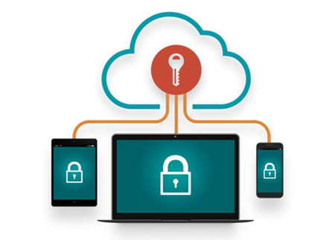
ACCESS MANAGEMENT
Team:- HIGH VOLTAGE
BY:- Himanshu Kumar Sharma

Slide 2

Access Management
Sanofi Access
Trial Operation (SSP)
Click here to START
Click here to START

Slide 3



Access Requests
Sanofi Access
1
2
3
4
5
WISE & Satellites Applications – Access & Directory Management
Application/Tools request for the role assigned on Sanofi.
Role Assignment
Sanofi Portal Access
CLINBOX2WISE

Slide 4
Role Assignment process
For each Associate there is a Role assignment with the definition of each is provided to Sanofi Pasteur Global Operational Manager/Clinical outsourcing expert.
Basically We have three Generic Role
Data Manager (DM)
Database Developer (DBD)
Data Management Programmer (DMP)
2. Team leader will help in getting the role.
3

Slide 5
Access Process Prerequisites
Do the study team member is eligible for the access to systems
Request Access
Role Assigner
Assigns a role to study team member
Once receive invitation to create the network access
Do user have an active network account
Is all the mandatory training is completed.
Received notification and completed all the required training
Access Granted

Slide 6
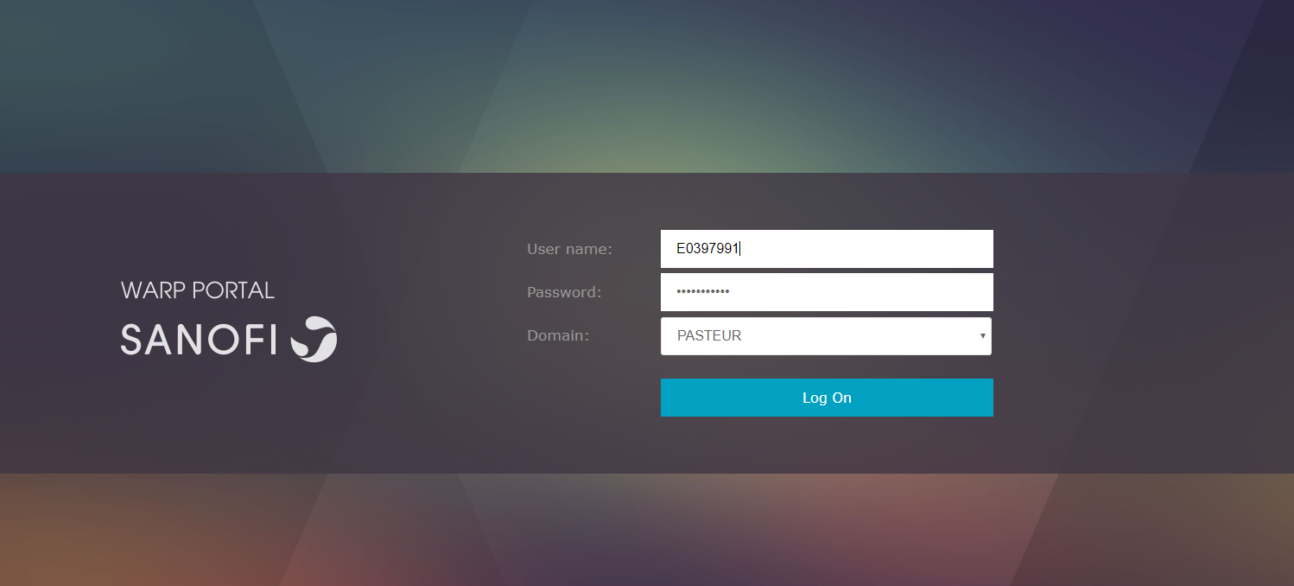
Sanofi Portal Access
Sanofi unified access need permission for Citrix, we need to have unique E0ID, Soft Token Request, Le@rn, Eroom and all the applicable tools valid for the role assigned to you.
Please contact your POC or access manager for raising the request on Sanofi share point.
Its takes around 10-15 days to get with all the valid access.
Once you receive the access for Citrix we can log in to citrix with one time password and generate your permanent password.

Slide 7
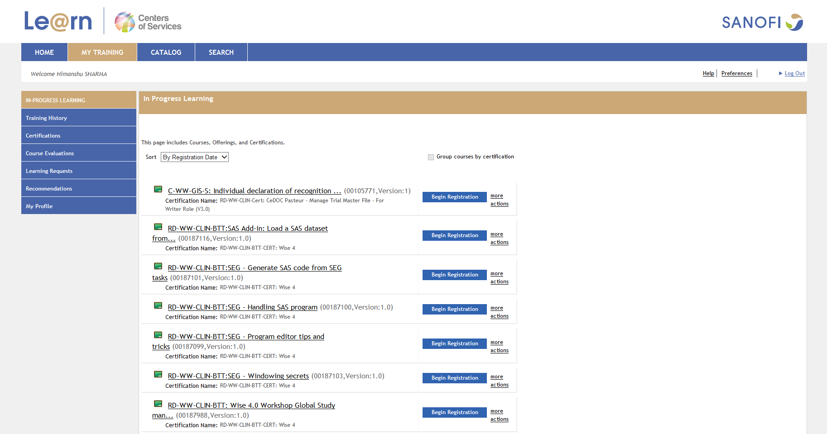
Le@rn Portal
Before proceeding to further requests for ARMADA and other application/tools, we need to complete all the e-leaning mention in the Le@rn portal.
Open the Le@rn portal available in the Favorites folder on the desktop and navigate like this
https://lms.sanofi.com/Saba/Web/Main
Click to Begin Registration
1
2
3
Available learnings

Slide 8
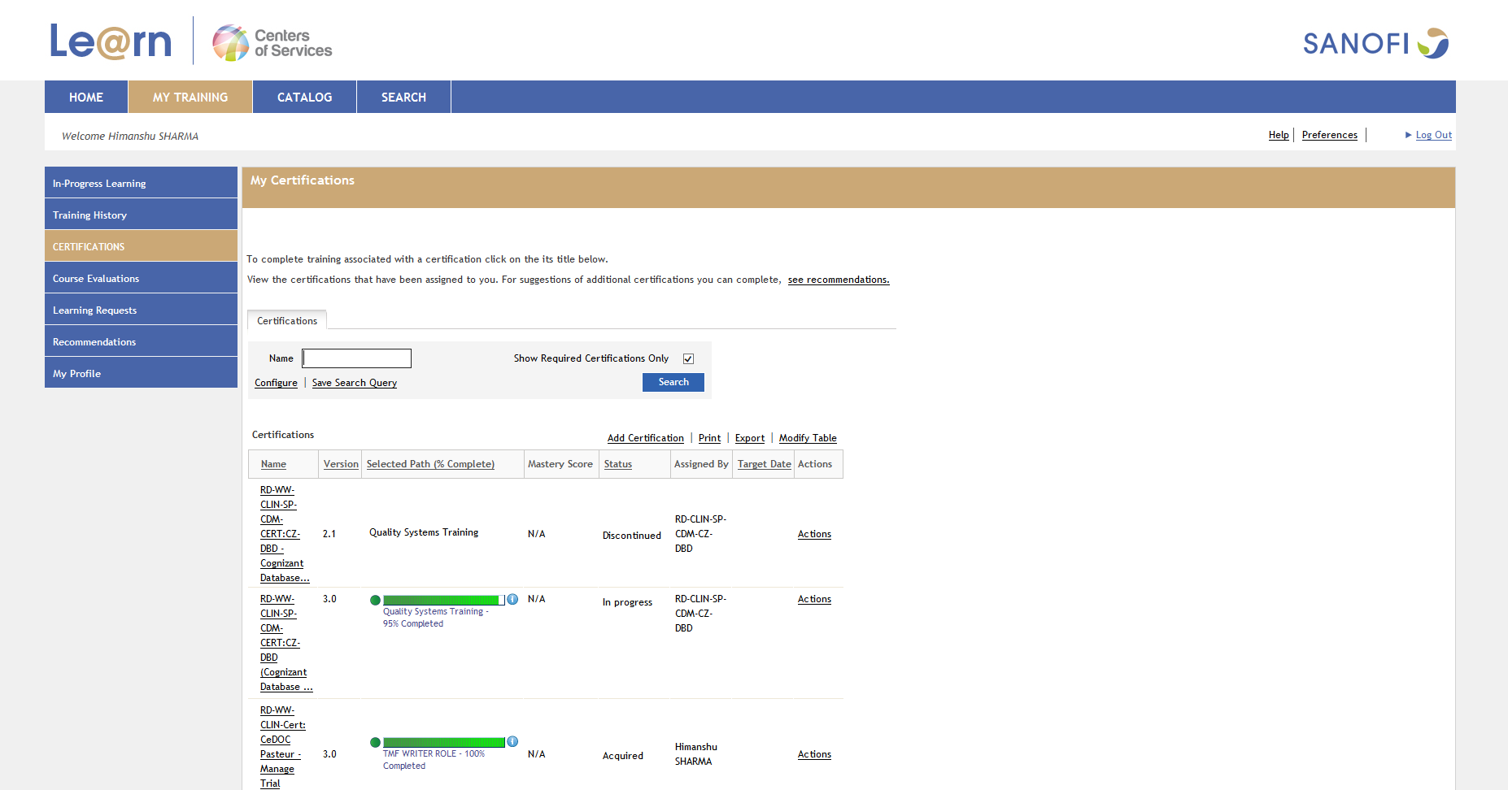
Further you can check whether you have completed all the required learning..
1
2
All recommended eLearning.

Slide 9
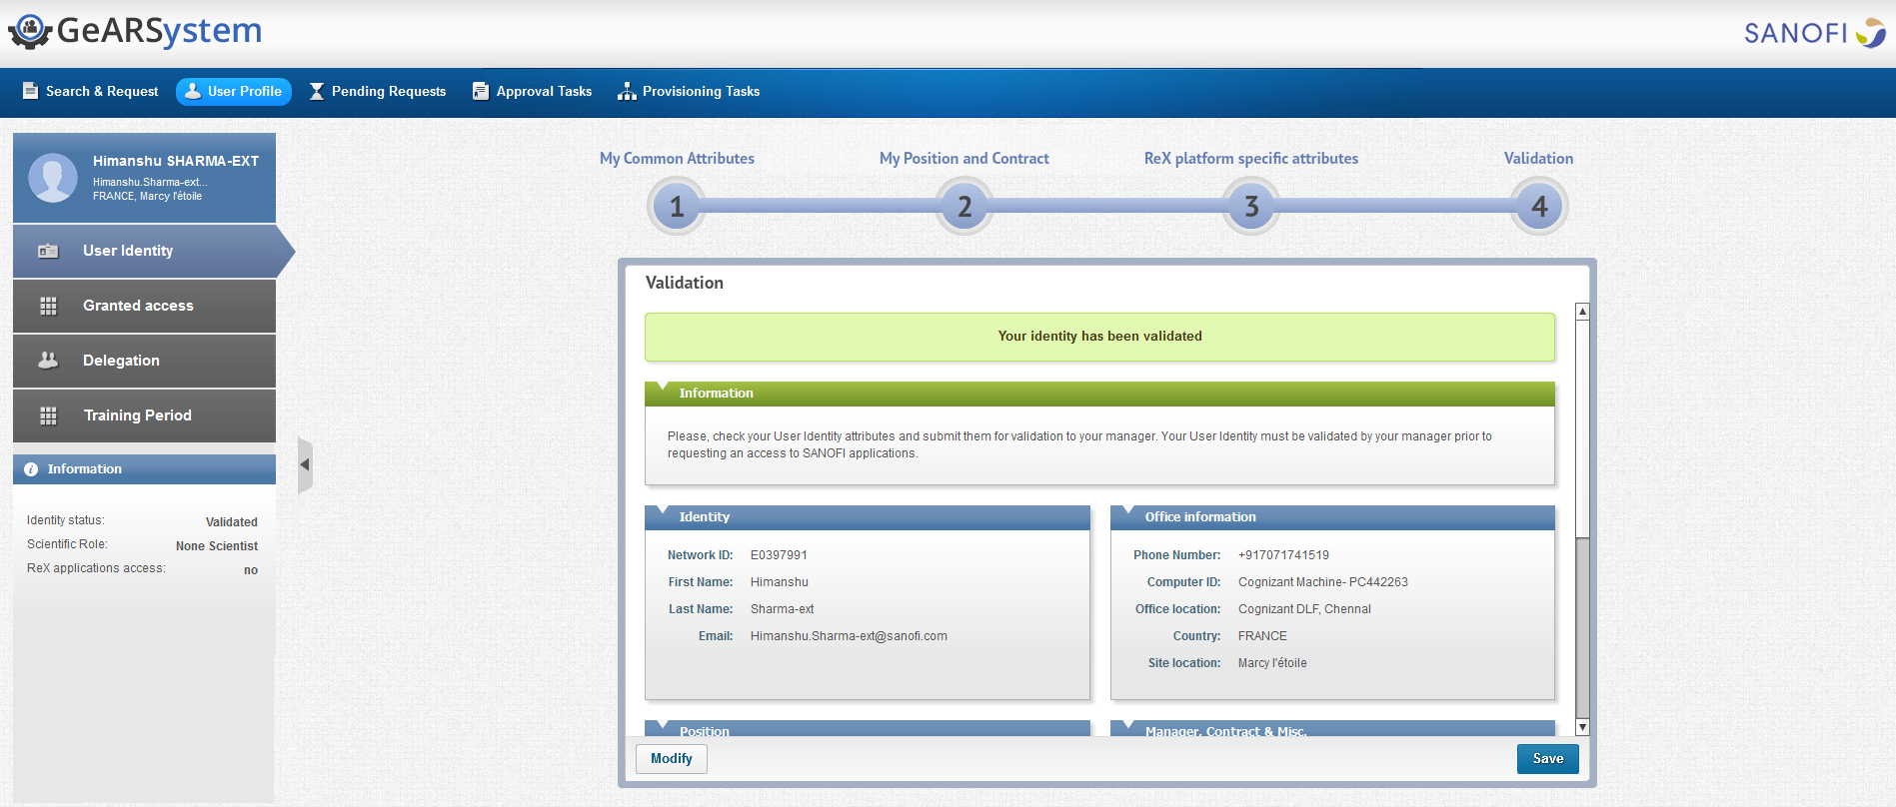
WISE & Satellites Applications – Access & Directory Management
To raise request for WISE
Complete the e-Learning Module in the Sanofi Le@rn.
Go Gears Service portal, https://gears.sanofi.com/Main.jsp#
In order to raise requite we need to make sure our profile is complete in the Gears.
It Takes One day for the profile to get approved.
Fill the required and Save

Slide 10
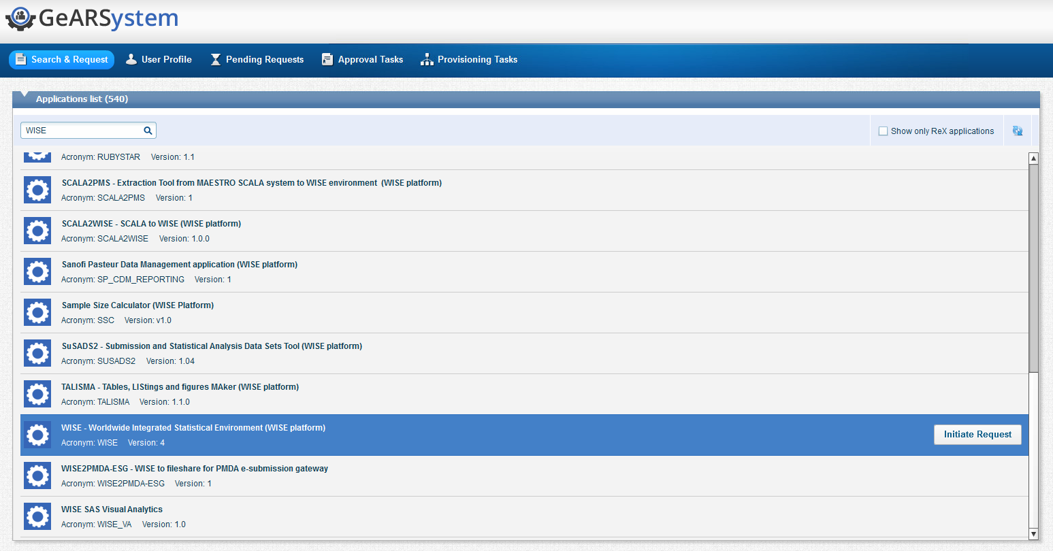
Continued…
Once the profile is accepted. Go to the Gears and follow these easy steps.
1. Go to Search & Request
2. Search for WISE
3. Initiate Request

Slide 11
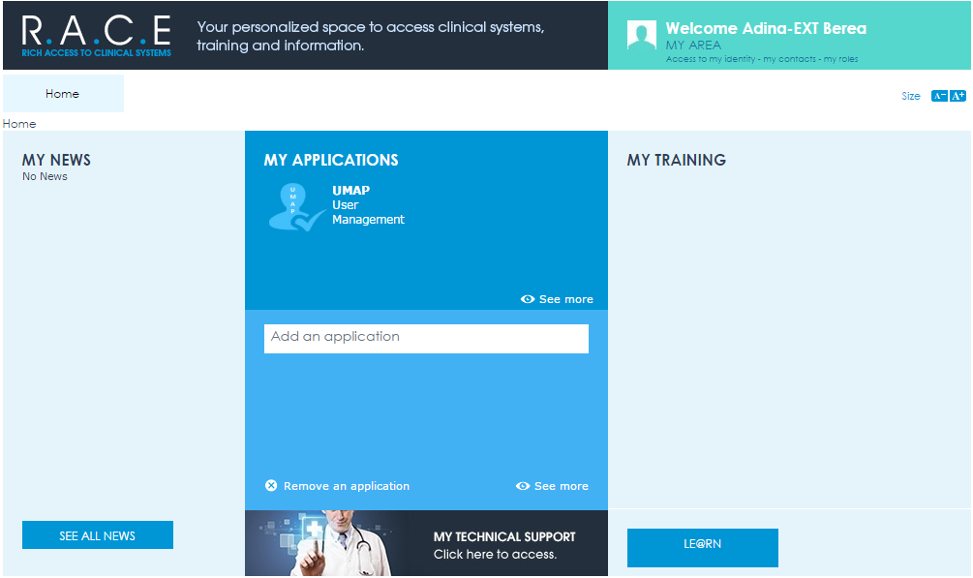
User access tools and their related tools/training
RACE is the personalized space for access of clinical system.
To grant access to relevant tools, open to the RACE portal. There will be only one application listed i.e. .(UMAP)
Go to UMAP and grant access for applicable tools such as ARMADA, Ce-DOC and RAVE.
These access availability depends on the role you have assigned.
https://race.sanofi.com/Pages/default.aspx

Slide 12
Continued...
For the first time..
To get access request in the UMAP, the trail lead need to assign you a role into the Role management (RPI) so that you can grant access for yourself.
Once the trail lead grant you the access, you can go to the clinical system access management(CSAM) and perform the required.
CSAM
Access Management
ARMADA
RACE Portal
UMAP
CeDOC Pasteur
RAVE
DBD

Slide 13
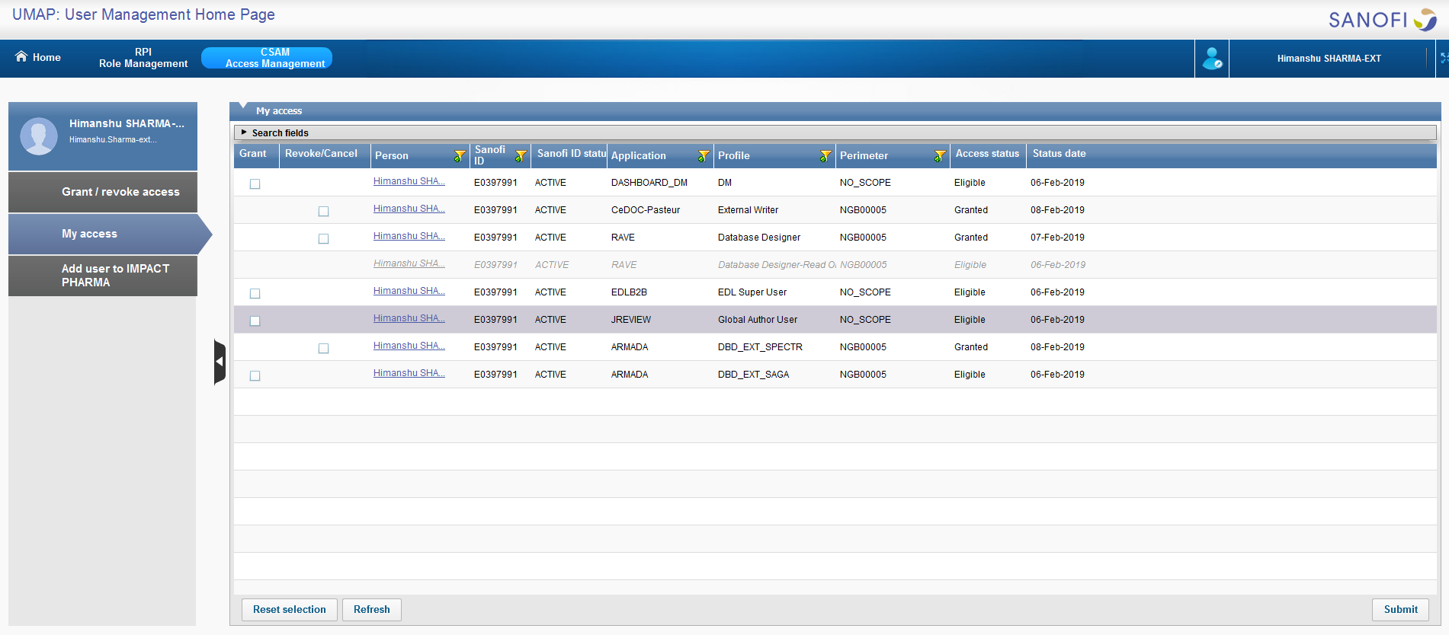
Follow-up…
✓
✓
✓

Slide 14
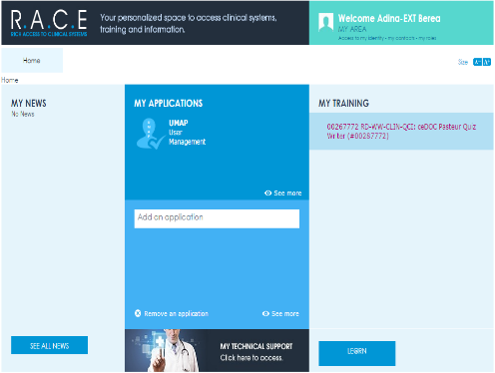
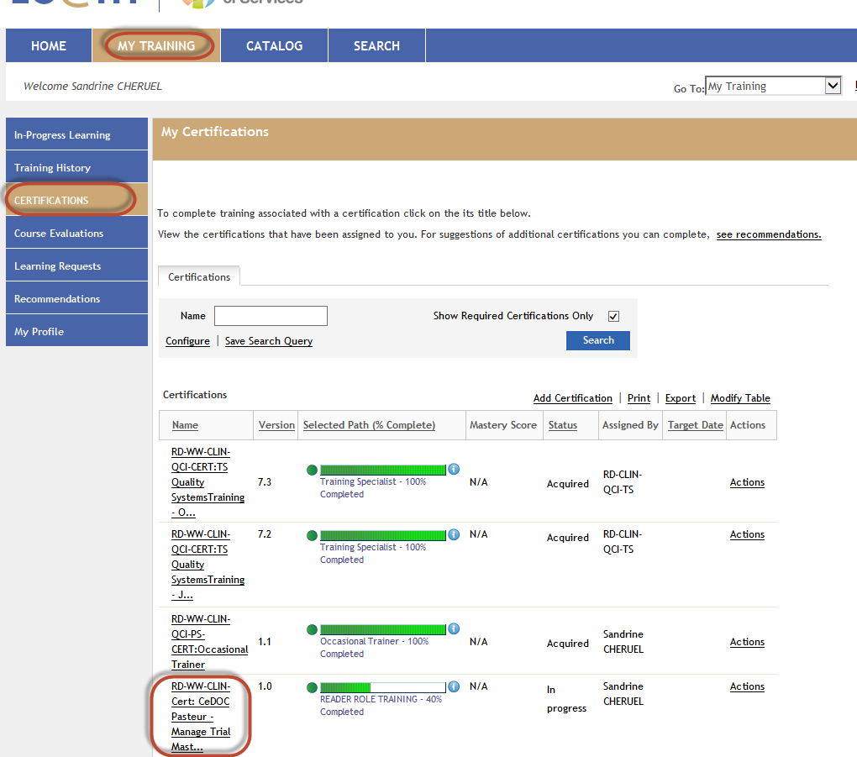


Application Access
Once you granted the access in CSAM, all the application will be listed on the RACE portal.
In order to access the application you need to complete all the mandatory e-learnings listed in the race portal. Once you complete it application will be available for use.

Slide 15
RAVE Access
To get the rave access you to go through RAVE SDBE training session, it’s a 5 day full flag training on rave tool.
Once the training is completed the access manager will share your attendances to the Le@rn ADMIN.
You should attend all the classes in order to mark for access.

Slide 16
Continued…
Once the access is recommended by Sanofi.
Go to RACE and select the UMAP, go to CSAM and Grant access to RAVE (Database Designer).
After access request is granted in the CSAM, you will get the RAVE activation mail.
Go with the mail and fill the form in the rave portal.
I order to access the Study in rave you must complete the e-learning on the Rave portal.

Slide 17
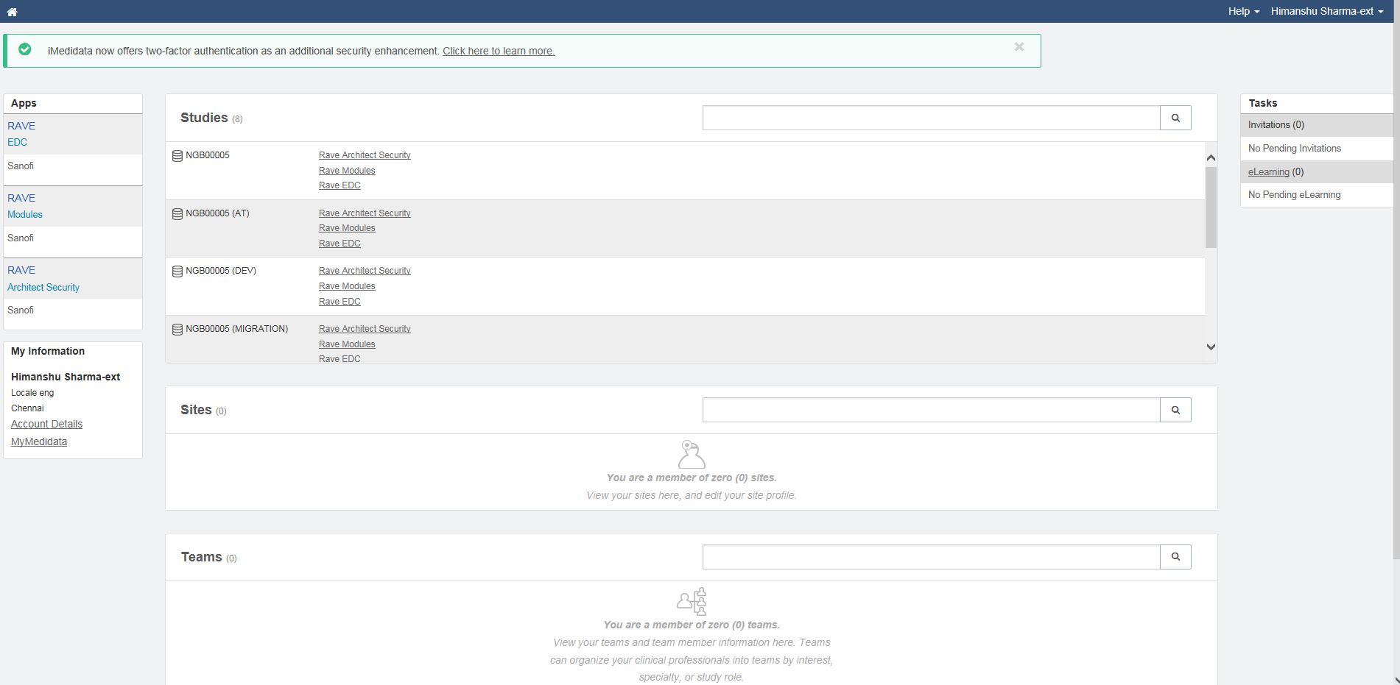
Rave Console
Studies
E-Learning

Slide 18
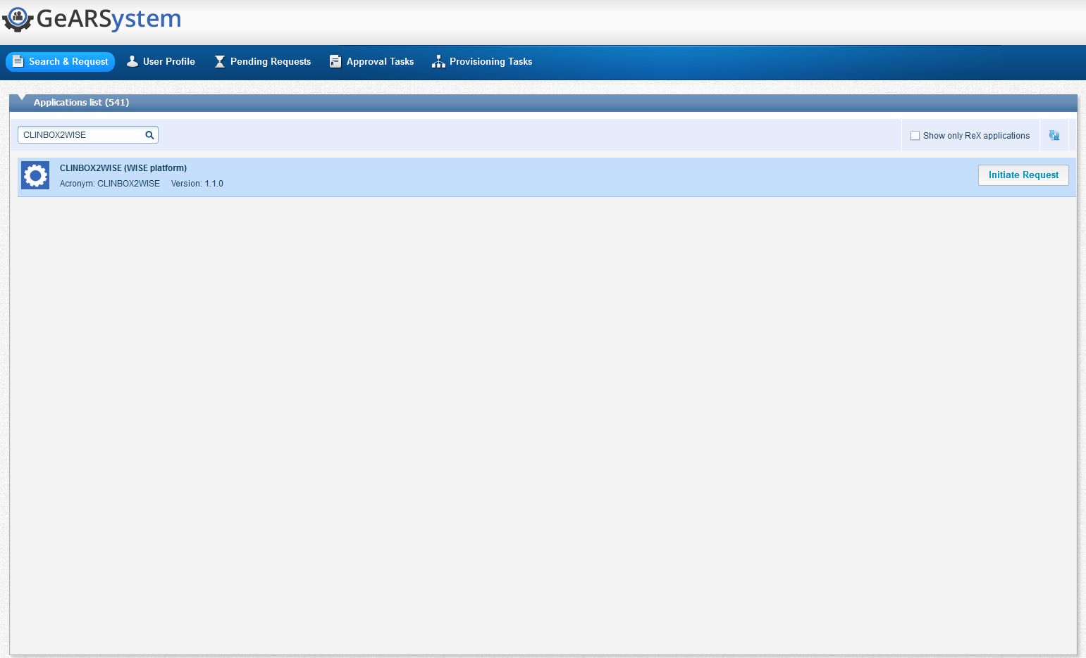
Access to CLINBOX2WISE
To get the CLINBOX2WISE access follow simple steps
Go to GeARSystem https://gears.sanofi.com/Main.jsp#
Search & Request
Search in the search box
Initiate Request

Slide 19

We have Completed the access requirement for SP
Now Let’s See How the Procedure is for
For the Trial Operation (SSP model)
Click here to continue

Slide 20
For the Trial Operation (SSP model)
1
2
3
4
E0 ID,
WRAP &
Le@rn Account
Role Assigned in
[ IMPACT ]
Application/Tools request.
Rave Study
Access in
UMAP

Slide 21
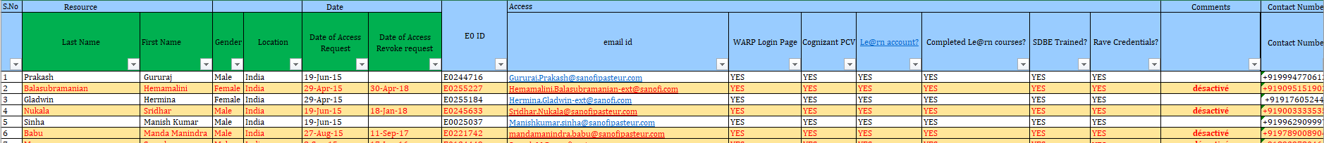
  Creation of E0 account
1. Cognizant TA Leads enter new Cognizant team member in the excel file.
This file is located in https://mp-erooms.global.f9.enterprise/eRoom/CSO/CSO_TO/0_8240a
2. Cognizant TA Leads send an alert from the e-room to inform Sanofi DES assistant that new collaborators are added in the file.
  3. Sanofi DES assistant to request for an ID via ITS portal
    The ID request number to be reported in the Cognizant_collaborators.xls in the “comment” column (In order to ease the FUP of this request in case of absent or any further questions)
    The manager who has to be indicated is Maxime GUIGNET (DES SSP expert).
    When it is done, an email from ITS is sent with the E0 ID account number & Sanofi DES assistant report the E0 id into the Cognizant_collaborators.xls.

Slide 22
WARP access & Le@rn account
    WARP
      The Sanofi DES assistant will send an email to GIS_RSD_EMEA_AM_L3@sanofi.com and copy Pascal Briand to ask for adding the collaborator to the group E00 APP FE-WTS Cognizant-TO for the WARP.
      When it is done, an email from GIS is sent for informing that it is ok for the Warp.
      After all the request is granted go to below link to access.
        https://warp-emea-partners.sanofi.com/Citrix/WARPWeb/
    Le@rn Account
    The Sanofi DES assistant will request for Learn Account via ITS portal for the access.
    Once the access is granted, need to complete all the mandatory e-learning applicable for you.

Slide 23

Role assignment in IMPACT
For the role assignment the Sanofi DES assistant raise a request on IMPACT.
CONGRATULATION
Role Assigned:- Database Design Analyst]
SAME AS SP
Application access.
RAVE Study access
Rave Study access needs to be provided via UMAP
DBD Lead will provide the access
ARMADA access to be provided via UMAP for the first study. For rest of the studies, team can ask the Sanofi DBD to grant access from SPECTR

Slide 24

Completed
Quiz
The e-learning is completed
Click here to
START

Slide 25
What is RACE ?
RACE is the personalized space for access of clinical system.
e-Learning Module in the Sanofi Le@rn.
None of the above
Management Protocol

Slide 26
For each Associate there is a Role assigned and the Generic Role are
Data Manager (DM)
Database Developer (DBD)
Data Management Programmer (DMP)
All of the above

Slide 27
To get access request in the UMAP.
The trail lead need to assign you a role into the Role management (RPI)
Go to RACE and grant access
None of the above
Go to RPI and take your role

Slide 28
After you get the access for le@rn what is the most important thing you should do.
Complete all the mandatory E-learning
Get all the access
None of the above
Go to gears and fill the form

Slide 29
Where will the role assignment request be sent in case of Trial Operation (SSP)
IMPACT
ARMADA
None of the above
Go to Excel file for the required

Slide 30

You have Finished the Quiz
Thank you for you valuable Time
Kindly Click Here for the result

Slide 31

Thank you
H GH VOLTAGE
Team

